Slide 1
CS 525
Advanced Distributed Systems
Spring 2011
Indranil Gupta (Indy)
Membership Protocols (and Failure Detectors)
March 31, 2011
All Slides © IG

Slide 2
Target Settings
Process ‘group’-based systems
  Clouds/Datacenters
  Replicated servers
  Distributed databases
Crash-stop/Fail-stop process failures

Slide 3

Group Membership Service
Application Queries
e.g., gossip, overlays, DHT’s, etc.
Application Process pi
joins, leaves, failures
of members
Membership
Protocol
Membership List
Group
Membership List
Unreliable
Communication
Notes:
- say “non-byzantine”
ANIMATE!

Slide 4
Two sub-protocols
Application Process pi
pj
Dissemination
Almost-Complete list (focus of this talk)
  Gossip-style, SWIM, Virtual synchrony, …
Or Partial-random list (other papers)
  SCAMP, T-MAN, Cyclon,…
Failure Detector
Group
Membership List
Unreliable
Communication
Notes:
- say “non-byzantine”

Slide 5
Large Group: Scalability A Goal
Process Group
this is us (pi)
“Members”
1000’s of processes
Unreliable Communication
Network
Notes:
- say “non-byzantine”

Slide 6
Group Membership Protocol
II
Failure Detector
Some process
finds out quickly
pi
I pj crashed
pj
III
Dissemination
Unreliable Communication
Network
Crash-stop Failures only
Notes:
- animate f-d and then dissemination?
- say “non-byzantine”

Slide 7
I. pj crashes
Nothing we can do about it!
A frequent occurrence
Common case rather than exception
Frequency goes up at least linearly with size of datacenter

Slide 8
II. Distributed Failure Detectors: Desirable Properties
Completeness = each failure is detected
Accuracy = there is no mistaken detection
Speed
  Time to first detection of a failure
Scale
  Equal Load on each member
  Network Message Load

Slide 9
Distributed Failure Detectors: Properties
Impossible together in
lossy networks [Chandra
and Toueg]
If possible, then can
solve consensus!
Completeness
Accuracy
Speed
  Time to first detection of a failure
Scale
  Equal Load on each member
  Network Message Load

Slide 10
What Real Failure Detectors Prefer
Guaranteed
Completeness
Accuracy
Speed
  Time to first detection of a failure
Scale
  Equal Load on each member
  Network Message Load
Partial/Probabilistic
guarantee

Slide 11
Failure Detector Properties
Guaranteed
Completeness
Accuracy
Speed
  Time to first detection of a failure
Scale
  Equal Load on each member
  Network Message Load
Partial/Probabilistic
guarantee
Time until some
process detects the failure

Slide 12
Failure Detector Properties
Guaranteed
Completeness
Accuracy
Speed
  Time to first detection of a failure
Scale
  Equal Load on each member
  Network Message Load
Partial/Probabilistic
guarantee
Time until some
process detects the failure
No bottlenecks/single
failure point

Slide 13
Failure Detector Properties
Completeness
Accuracy
Speed
  Time to first detection of a failure
Scale
  Equal Load on each member
  Network Message Load
In spite of
arbitrary simultaneous
process failures

Slide 14
Centralized Heartbeating
☹ Hotspot
pi
…
pi, Heartbeat Seq. l++
pj
Heartbeats sent periodically
If heartbeat not received from pi within
timeout, mark pi as failed

Slide 15
Ring Heartbeating
☹ Unpredictable on
simultaneous multiple failures
pi
pi, Heartbeat Seq. l++
pj
…
…

Slide 16
All-to-All Heartbeating
☺ Equal load per member
pi
pi, Heartbeat Seq. l++
…
pj

Slide 17
Gossip-style Heartbeating
☺ Good accuracy properties
pi
Array of
Heartbeat Seq. l
for member subset

Slide 18
Gossip-Style Failure Detection
1 | 10118 | 64
2 | 10110 | 64
3 | 10090 | 58
4 | 10111 | 65
1 | 10120 | 66
2 | 10103 | 62
3 | 10098 | 63
4 | 10111 | 65
2
1
Address
Time (local)
1 | 10120 | 70
2 | 10110 | 64
3 | 10098 | 70
4 | 10111 | 65
Heartbeat Counter
4
Protocol:
Nodes periodically gossip their membership list
On receipt, the local membership list is updated
3
Current time : 70 at node 2
(asynchronous clocks)
Fig and animation by: Dongyun Jin and Thuy Ngyuen

Slide 19
Gossip-Style Failure Detection
If the heartbeat has not increased for more than T_{fail} seconds,
the member is considered failed
And after T_{cleanup} seconds, it will delete the member from the list
Why two different timeouts?

Slide 20
Gossip-Style Failure Detection
What if an entry pointing to a failed node is deleted right after T_{fail} seconds?
Fix: remember for another T_{fail}
1 | 10120 | 66
2 | 10110 | 64
3 | 10098 | 75
4 | 10111 | 65
1 | 10120 | 66
2 | 10110 | 64
3 | 10098 | 50
4 | 10111 | 65
1 | 10120 | 66
2 | 10110 | 64
4 | 10111 | 65
1 | 10120 | 66
2 | 10103 | 62
3 | 10098 | 55
4 | 10111 | 65
2
1
Current time : 75 at node 2
4
3

Slide 21
Multi-level Gossiping
Network topology is hierarchical
Random gossip target selection => core routers face O(N) load (Why?)
Fix: Select gossip target in subnet I, which contains n_{i} nodes, with probability 1/n_{i}
Router load=O(1)
Dissemination time=O(log(N))
  Why?
What about latency for multi-level topologies?
[Gupta et al, TPDS 06]
N/2 nodes in a subnet
Router
N/2 nodes in a subnet

Slide 22
Analysis/Discussion
What happens if gossip period T_{gossip} is decreased?
A single heartbeat takes O(log(N)) time to propagate. So: N heartbeats take:
  O(log(N)) time to propagate, if bandwidth allowed per node is allowed to be O(N)
  O(N.log(N)) time to propagate, if bandwidth allowed per node is only O(1)
  What about O(k) bandwidth?
What happens to P_{mistake} (false positive rate) as T_{fail} ,T_{cleanup} is increased?
Tradeoff: False positive rate vs. detection time

Slide 23
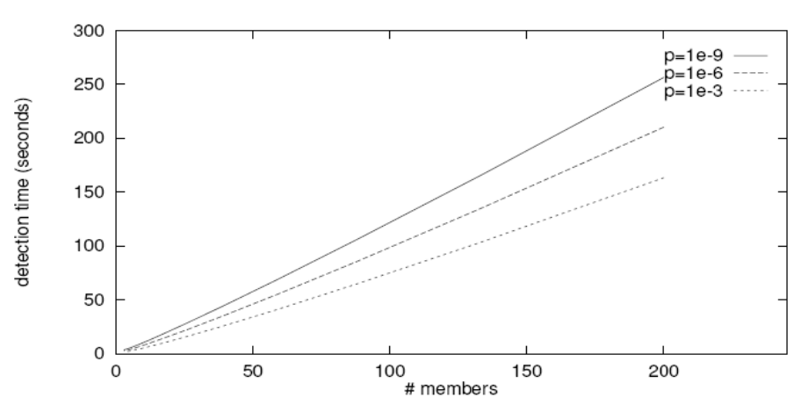
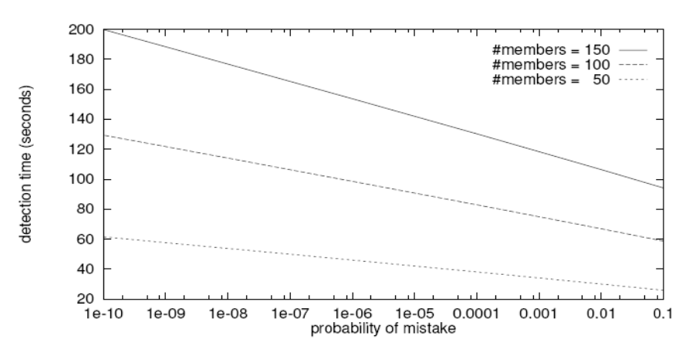
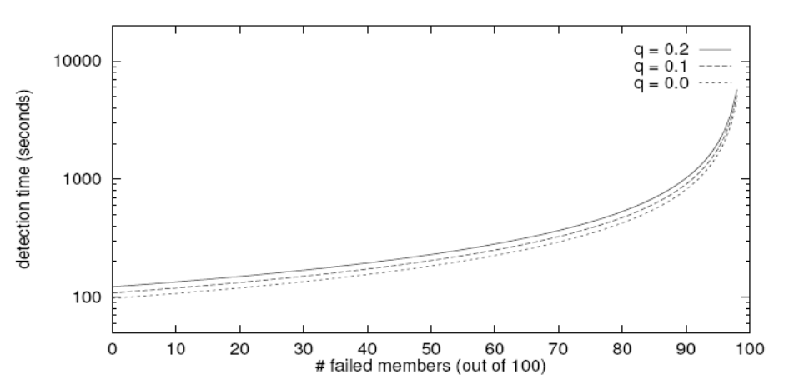
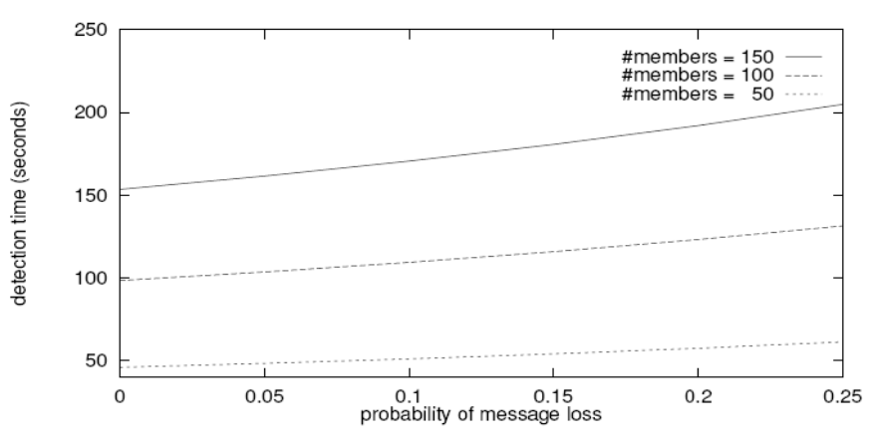
Simulations
As # members increases, the detection time increases
As requirement is loosened, the detection time decreases
As # failed members increases, the detection time increases significantly
The algorithm is resilient to message loss

Slide 24
Failure Detector Properties …
Completeness
Accuracy
Speed
  Time to first detection of a failure
Scale
  Equal Load on each member
  Network Message Load

Slide 25
…Are application-defined Requirements
Guarantee always
Completeness
Accuracy
Speed
  Time to first detection of a failure
Scale
  Equal Load on each member
  Network Message Load
Probability PM(T)
T time units

Slide 26
…Are application-defined Requirements
Guarantee always
Completeness
Accuracy
Speed
  Time to first detection of a failure
Scale
  Equal Load on each member
  Network Message Load
Probability PM(T)
T time units
N*L: Compare this across protocols

Slide 27
All-to-All Heartbeating
pi
Every T units
pi, Heartbeat Seq. l++
L=N/T
…

Slide 28
Gossip-style Heartbeating
T=logN * tg
pi
Array of
Heartbeat Seq. l
for member subset
L=N/tg=N*logN/T
Every tg units
=gossip period,
send O(N) gossip
message

Slide 29
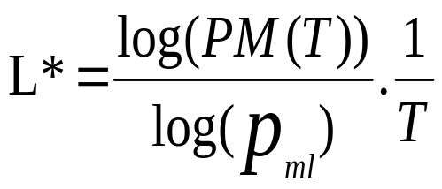
What’s the Best/Optimal we can do?
Worst case load L*
  as a function of T, PM(T), N
  Independent Message Loss probability p_{ml}
(proof in PODC 01 paper)

Slide 30
Heartbeating
Optimal L is independent of N (!)
All-to-all and gossip-based: sub-optimal
    L=O(N/T)
    try to achieve simultaneous detection at all processes
    fail to distinguish Failure Detection and Dissemination components
Key:
  Separate the two components
  Use a non heartbeat-based Failure Detection Component
Notes:
Remove the elaborate h-b scheme slides, and include more information on this slide.

Slide 31
SWIM Failure Detector Protocol
pi
pj
random pj
ping
K random
processes
X
ack
random K
ping-req
X
Protocol period
= T’ time units
ping
ack
ack
Notes:
Animate? May be slow.

Slide 32
SWIM versus Heartbeating
Heartbeating
O(N)
First Detection
Time
SWIM
Heartbeating
Constant
Process Load
For Fixed :
False Positive Rate
Message Loss Rate
Constant
O(N)

Slide 33

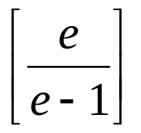
SWIM Failure Detector
Parameter | SWIM
First Detection Time | Expected periods Constant (independent of group size)
Process Load | Constant per period < 8 L* for 15% loss
False Positive Rate | Tunable (via K) Falls exponentially as load is scaled
Completeness | Deterministic time-bounded Within O(log(N)) periods w.h.p.

Slide 34
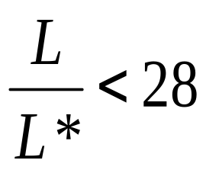
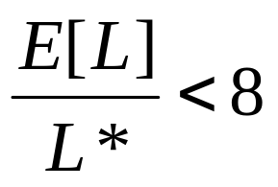
Accuracy, Load
PM(T) is exponential in -K. Also depends on pml (and pf )
  See paper
for up to 15 % loss rates
Notes:
Pr[pinging]; => expected detection time, whp detection time, wc detection time. (ind of n)
PM(T) can be calc’ed as a function of T, pml, pf (ind of n)
Trends on wc L/L* and E[L]/L*

Slide 35
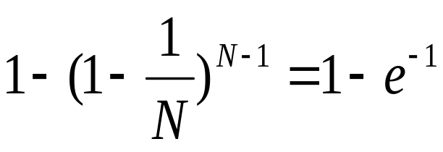
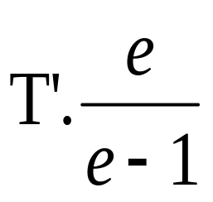
Detection Time
Prob. of being pinged in T’=
E[T ] =
Completeness: Any alive member detects failure
  Eventually
  By using a trick: within worst case O(N) protocol periods
Notes:
Put this up and say “converges” several times. Also say “independent” of N.
Pr[pinging]; => expected detection time, whp detection time, wc detection time. (ind of n)
PM(T) can be calc’ed as a function of T, pml, pf (ind of n)
Trends on wc L/L* and E[L]/L*

Slide 36
III. Dissemination
Failure Detector
Some process
finds out quickly
pi
pj crashed
Dissemination
Unreliable Communication
Network
HOW ?
Notes:
- animate f-d and then dissemination?
- say “non-byzantine”

Slide 37
Dissemination Options
Multicast (Hardware / IP)
  unreliable
  multiple simultaneous multicasts
Point-to-point (TCP / UDP)
  expensive
Zero extra messages: Piggyback on Failure Detector messages
  Infection-style Dissemination

Slide 38
Infection-style Dissemination
pi
pj
random pj
ping
K random
processes
X
ack
random K
ping-req
X
Protocol period
= T time units
ping
ack
Piggybacked
membership
information
ack
Notes:
Animate? May be slow.

Slide 39

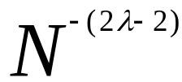
Infection-style Dissemination
Epidemic style dissemination
  After protocol periods, processes would not have heard about an update
Maintain a buffer of recently joined/evicted processes
  Piggyback from this buffer
  Prefer recent updates
Buffer elements are garbage collected after a while
  After protocol periods; this defines weak consistency
Notes:
Black fonts not visible
[ken] topological awareness, e.g., in a WAN-wide setting or an ad-hoc network with group members spread out over an area.

Slide 40
Suspicion Mechanism
False detections, due to
  Perturbed processes
  Packet losses, e.g., from congestion
Indirect pinging may not solve the problem
  e.g., correlated message losses near pinged host
Key: suspect a process before declaring it as failed in the group
Notes:
[rvr]: f-d more than a black-box, but as a ‘quality’ of connection to a process, e.g., weighing of gossip targets.

Slide 41
Suspicion Mechanism
pi
pi :: State Machine for pj view element
Dissmn
FD
Dissmn (Suspect pj)
FD:: pi ping failed
Dissmn::(Suspect pj)
Suspected
Time out
FD::pi ping success
Dissmn::(Alive pj)
Alive
Failed
Dissmn (Alive pj)
Dissmn (Failed pj)
Notes:
Use a pointer to show the 3 states.

Slide 42
Suspicion Mechanism
Distinguish multiple suspicions of a process
  Per-process incarnation number
  Inc # for pi can be incremented only by pi
    e.g., when it receives a (Suspect, pi) message
  Somewhat similar to DSDV
Higher inc# notifications over-ride lower inc#’s
Within an inc#: (Suspect inc #) > (Alive, inc #)
Nothing overrides a (Failed, inc #)
  See paper

Slide 43
Time-bounded Completeness
Key: select each membership element once as a ping target in a traversal
  Round-robin pinging
  Random permutation of list after each traversal
Each failure is detected in worst case 2N-1 (local) protocol periods
Preserves FD properties
Notes:
One slide is enough for this.

Slide 44
Results from an Implementation
Current implementation
  Win2K, uses Winsock 2
  Uses only UDP messaging
  900 semicolons of code (including testing)
Experimental platform
  Galaxy cluster: diverse collection of commodity PCs
  100 Mbps Ethernet
Default protocol settings
  Protocol period=2 s; K=1; G.C. and Suspicion timeouts=3*ceil[log(N+1)]
No partial membership lists observed in experiments

Slide 45
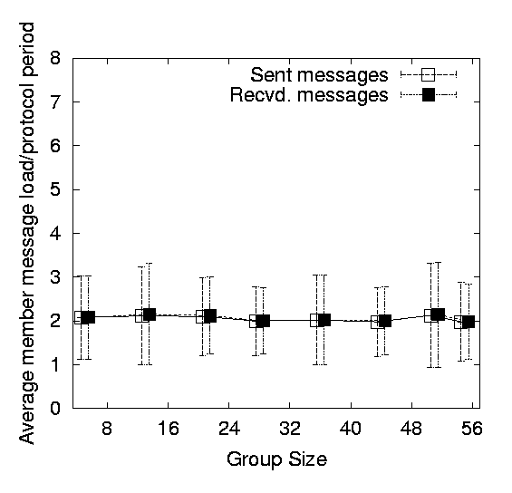
Per-process Send and Receive Loads
are independent of group size
Notes:
[rama]: why is “recvd” > “sent” at some points?
- ack’s may be received late, i.e., in a subsequent protocol period.

Slide 46
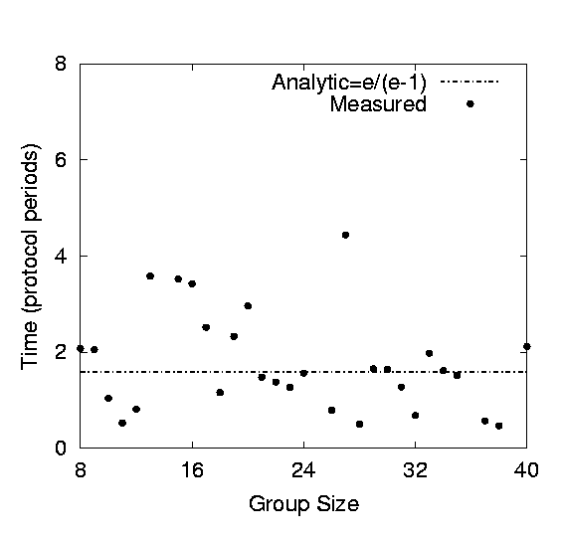
T1
T1+T2+T3
Time to First Detection of a process failure
Notes:
Why uneven bin sizes?
- arbitrary (point out the x’s first, then say that the bold line holds for an arbitrary binning)
- OR rm bins
- up to 40 since bcast only (only if asked)

Slide 47
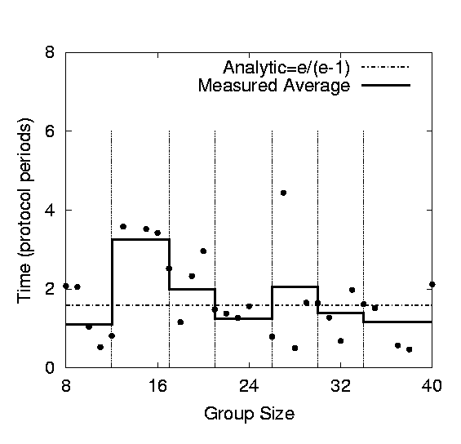
T1
T1+T2+T3
Time to First Detection of a process failure
apparently uncorrelated to group size
Notes:
- up to 40 since bcast only (only if asked)
---
Why uneven bin sizes?
ok - arbitrary (point out the x’s first, then say that the bold line holds for an arbitrary binning)
ok - OR rm bins

Slide 48
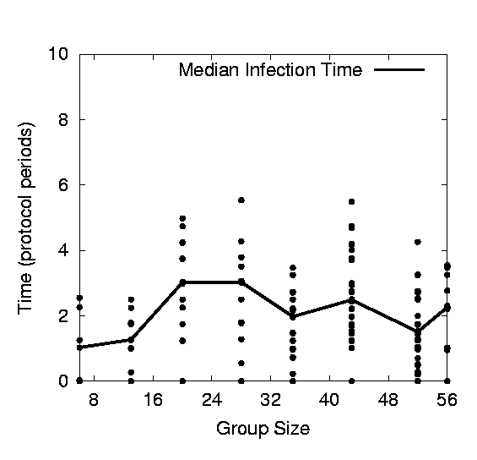
+
T2
T1+T2+T3
Membership Update Dissemination Time
is low at high group sizes
Notes:
[ken] all conclusions are too broad – “boiling the ocean”.
- why high values at 18 and 26?
- if you make the y-axis [0:20], will the bumps look less ominous?
The T1,T2,T3 fonts are so dark that they won’t be visible {global}

Slide 49
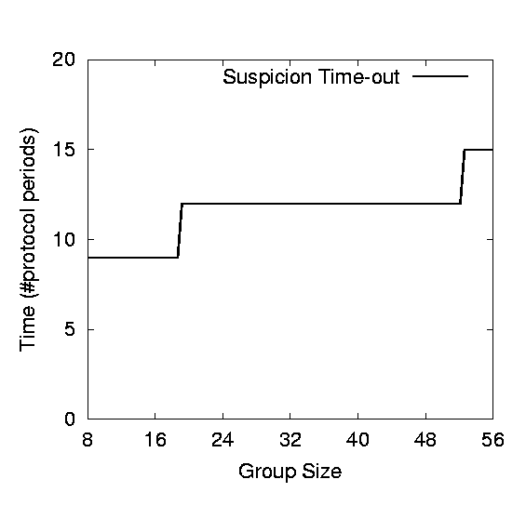
+
T3
T1+T2+T3
Excess time taken by
Suspicion Mechanism
Notes:
Get rid of this? No experimental information.

Slide 50
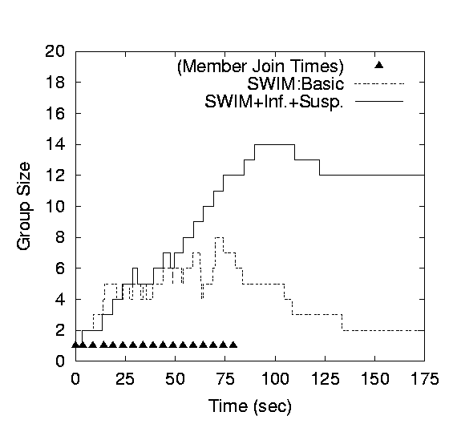
Benefit of Suspicion Mechanism:
Per-process 10% synthetic packet loss
Notes:
10 % is not on network ; it is per process
-----
Put up only basic (or +inf.) and +inf.+susp. ? (the difference between basic and +inf. is really due to the particular experimental run)

Slide 51
More discussion points
It turns out that with a partial membership list that is uniformly random, gossiping retains same properties as with complete membership lists
  Why? (Think of the equation)
  Partial membership protocols
    SCAMP, Cyclon, TMAN, …
Gossip-style failure detection underlies
  Astrolabe
  Amazon EC2/S3 (rumored!)
SWIM used in
  CoralCDN/Oasis anycast service: http://oasis.coralcdn.org
  Mike Freedman used suspicion mechanism to blackmark frequently-failing nodes

Slide 52
Reminder – Due this Sunday April 3rd at 11.59 PM
Project Midterm Report due, 11.59 pm [12pt font, single-sided, 8 + 1 page Business Plan max]
Wiki Term Paper - Second Draft Due (Individual)
Reviews – you only have to submit reviews for 15 sessions (any 15 sessions) from 2/10 to 4/28. Keep track of your count! Take a breather!

Slide 53
Questions

